Slide 1
PROBLEM STATEMENT
The defined business problem/question the data seeks to answer:
UNDERSTANDING THE AGE DISTRIBUTION
The data seeks to understand the age distribution of individuals who have sustained traumatic brain injuries (tbi)
It seeks to understand the specific age groups that are prone to traumatic brain injuries(tbi).

Slide 2
DATA SOURCES & DETAILS
The data for this project was sourced from:
CDC (Centers for Disease Control and Prevention):
The CDC is a primary source of data related to traumatic brain injuries (TBI). The data related to ED (Emergency Department) visits, hospitalizations, and deaths due to TBI is sourced from the CDC. The data can be found at the following URL: CDC
Data Content
The data entails information related to traumatic brain injuries (TBI) and is organized into several categories:
ED Visits, Hospitalizations, and Deaths:
This dataset contains information about TBI-related Emergency Department (ED) visits, hospitalizations, and deaths. It includes data on different mechanisms of injury, such as motor vehicle crashes, falls, assaults, and more. The data provides counts and rates for each mechanism of injury.
Age Group Data:
This dataset provides information about TBI by age group. It includes data related to age groups, types of measures, injury mechanisms, estimated observed cases, and rates per 100,000 people for the year 2014.
Yearly Data:
This dataset contains TBI data by year. It includes data on injury mechanisms, types of measures, years, rates per 100,000 people for the year 2014, and estimated observed cases for each year.

Slide 3
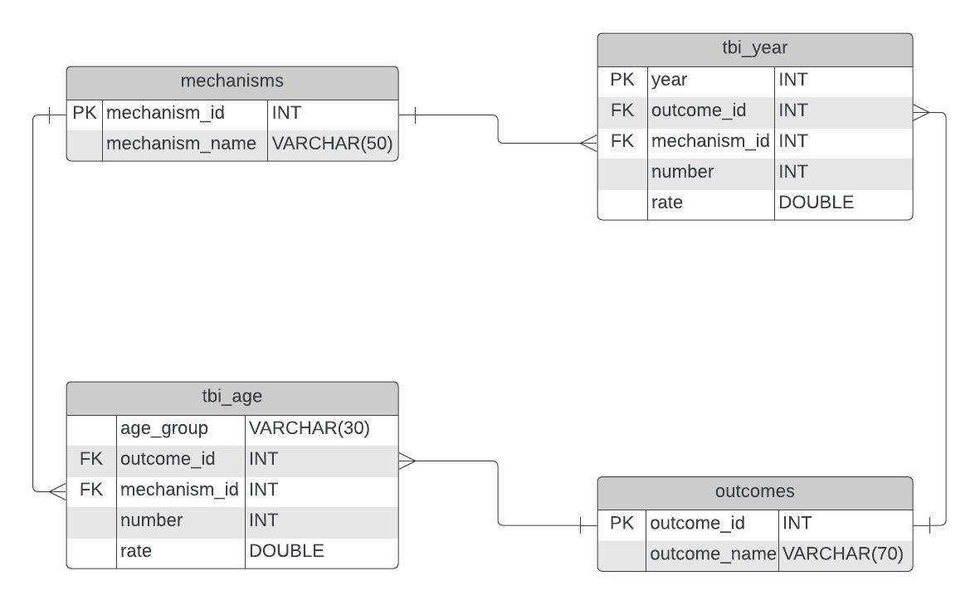
DATABASE DESIGN

Slide 4
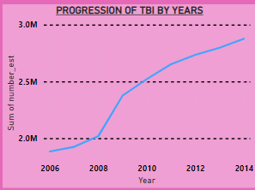
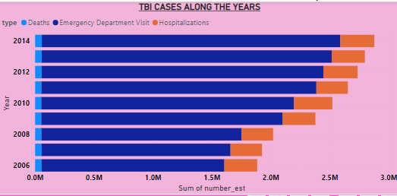
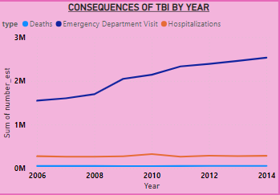
DATA VISUALIZATIONS AND INSIGHTS.
Insights Drawn from the Trends.
The total number of injuries has been increasing yearly.
There has been an increase in the number of emergency department visits over the years.
The proportion of hospitalizations and deaths has remained the same over the years.

Slide 5
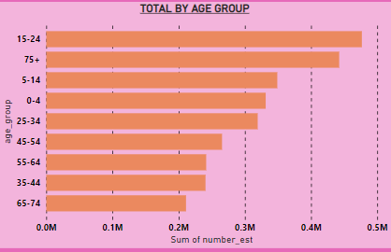
DATA VISUALIZATIONS AND INSIGHTS.
Insights
Children,Teenager,young adults and the elderly were the age groups that were most affected by the tbis.

Slide 6
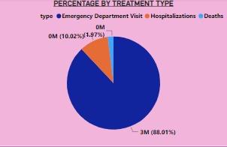
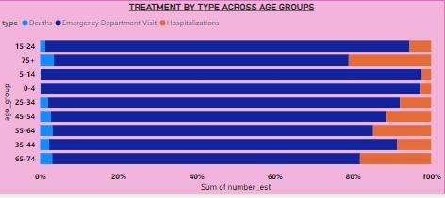
DATA VISUALIZATIONS AND INSIGHTS.
INSIGHTS
The most common outcome across all age groups who sustained TBIs was emergency visits.
The elderly were more likely to be hospitalized.
The children and teenager were less likely to die from the TBIs.

Slide 7
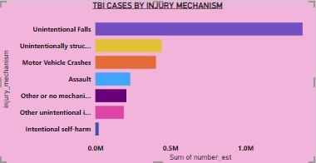
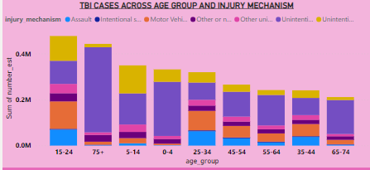
DATA VISUALIZATIONS AND INSIGHTS.
INSIGHTS
Majority of TBIs were caused by Unintentional Falls.
For the 0-4 age group, 71% tbis were caused by unintentional falls.
For the 75+ age group 84% tbis were caused by unintentional falls.
Intentional Self harm was the least type of mechanism that caused tbis.

Slide 8
GAPS & OPPORTUNITIES.
Injury Severity classification data would help explain in the treatment outcomes for the different age groups.
Could the pre existing health conditions have an impact on the outcomes?
More data on the injury mechanisms should be provided to better build preventative measures.
The data should have included the gender information of the affected persons for a better clarity on the causes of the tbis.
The military dataset did not give us the injury mechanisms and the treatment outcomes for comparison with the civilian data.

